Slide 1




SHRI GURU GOBIND SINGH JI GOVT. COLLEGE,
PAONTA SAHIB, SIRMOUR (H.P)

Slide 2
DR. KIRAN BALA SHARMA
(ASSTT. PROF. MUSIC INSTRUMENTAL) H.O.D.
MR. RAVINDER SHARMA
(ASSTT. PROF. MUSIC VOCAL)

Slide 3



Slide 4
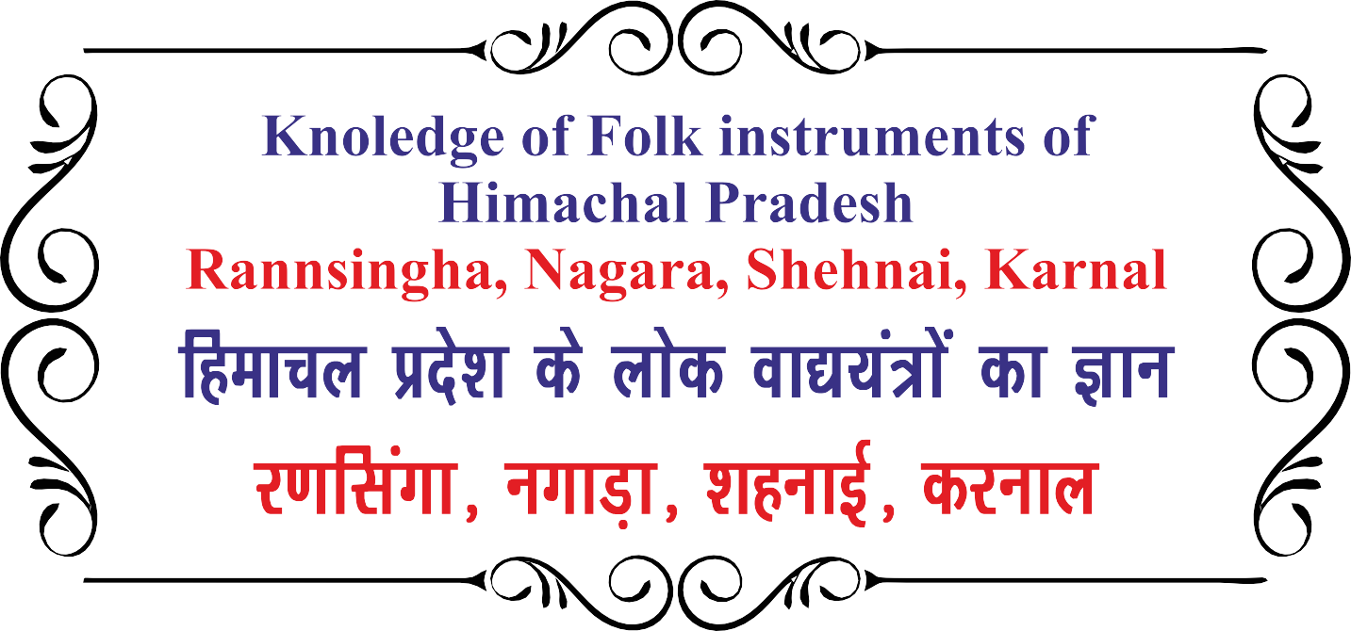

Slide 5
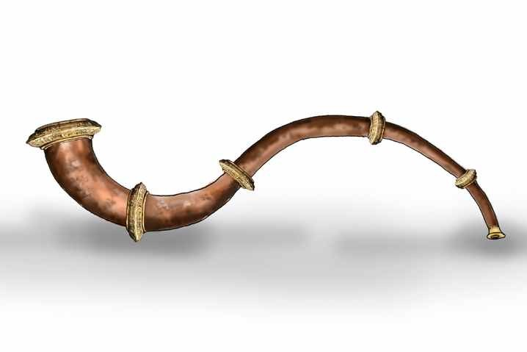

Slide 6
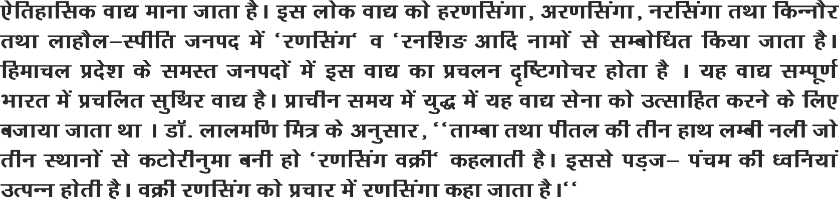

Slide 7
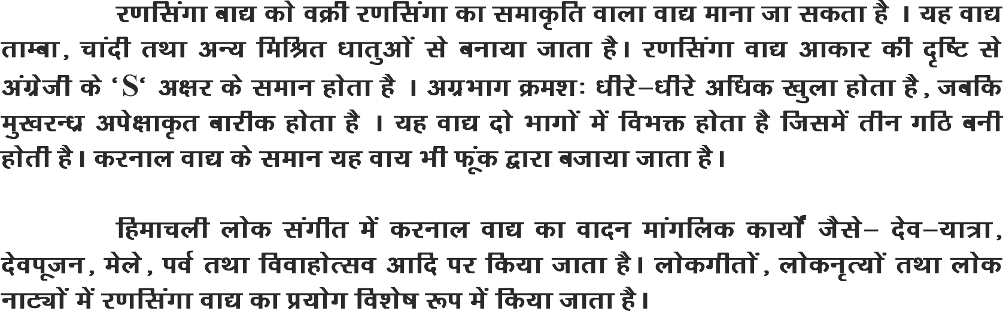

Slide 8
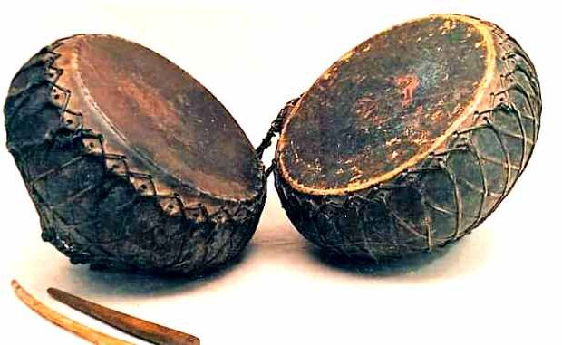

Slide 9
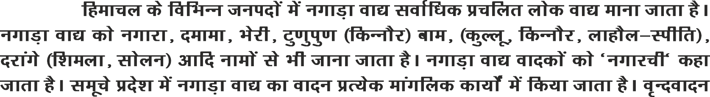
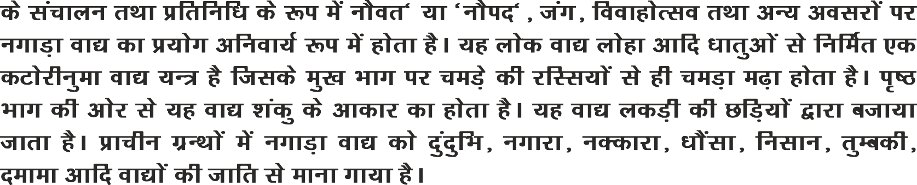

Slide 10
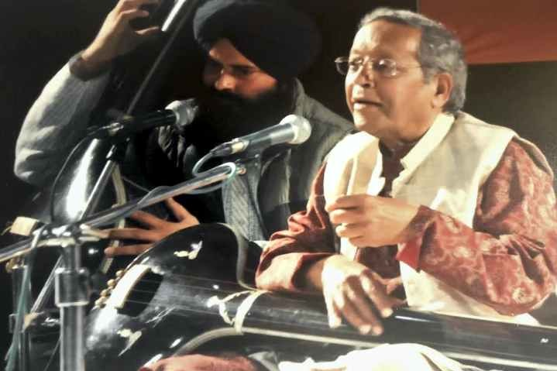


Slide 11

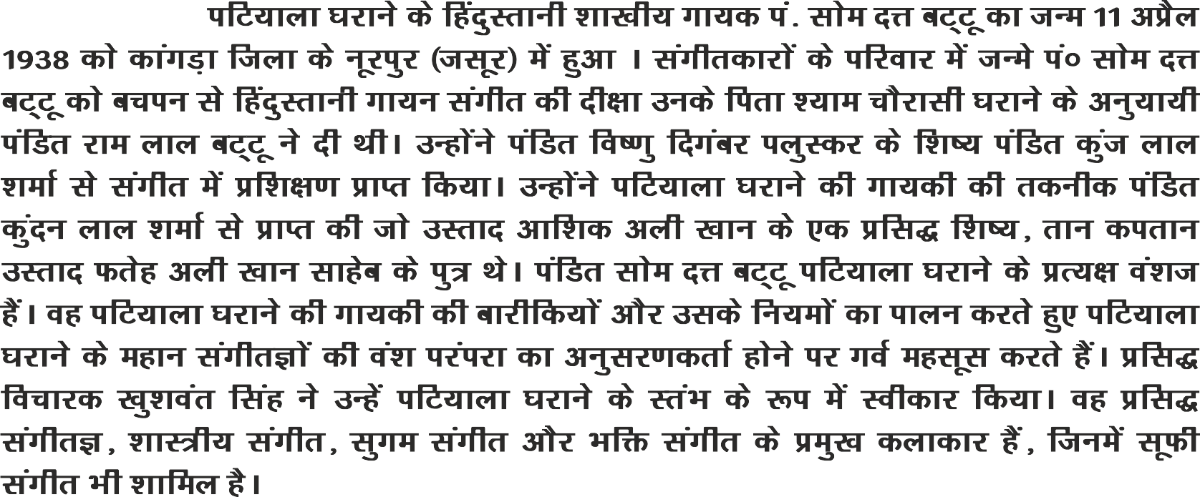

Slide 12
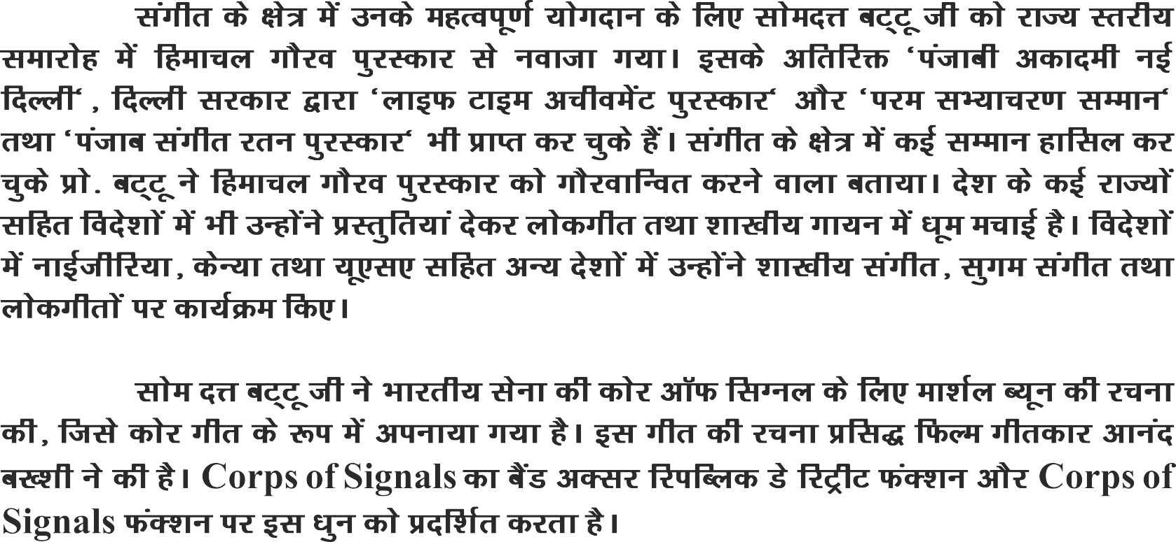

Slide 13
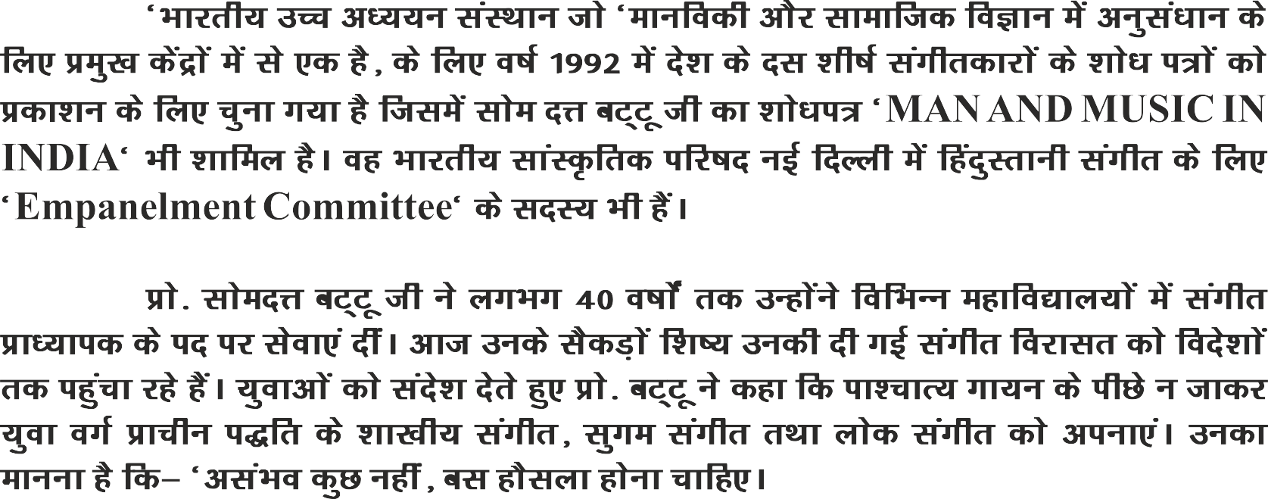

Slide 14


Slide 15
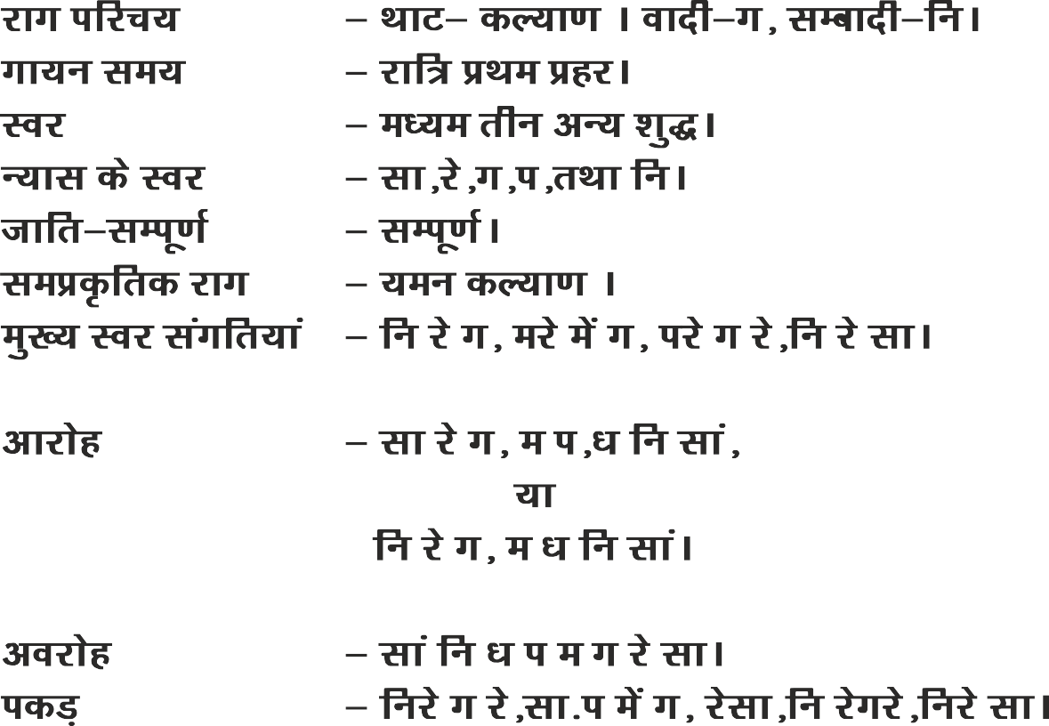

Slide 16
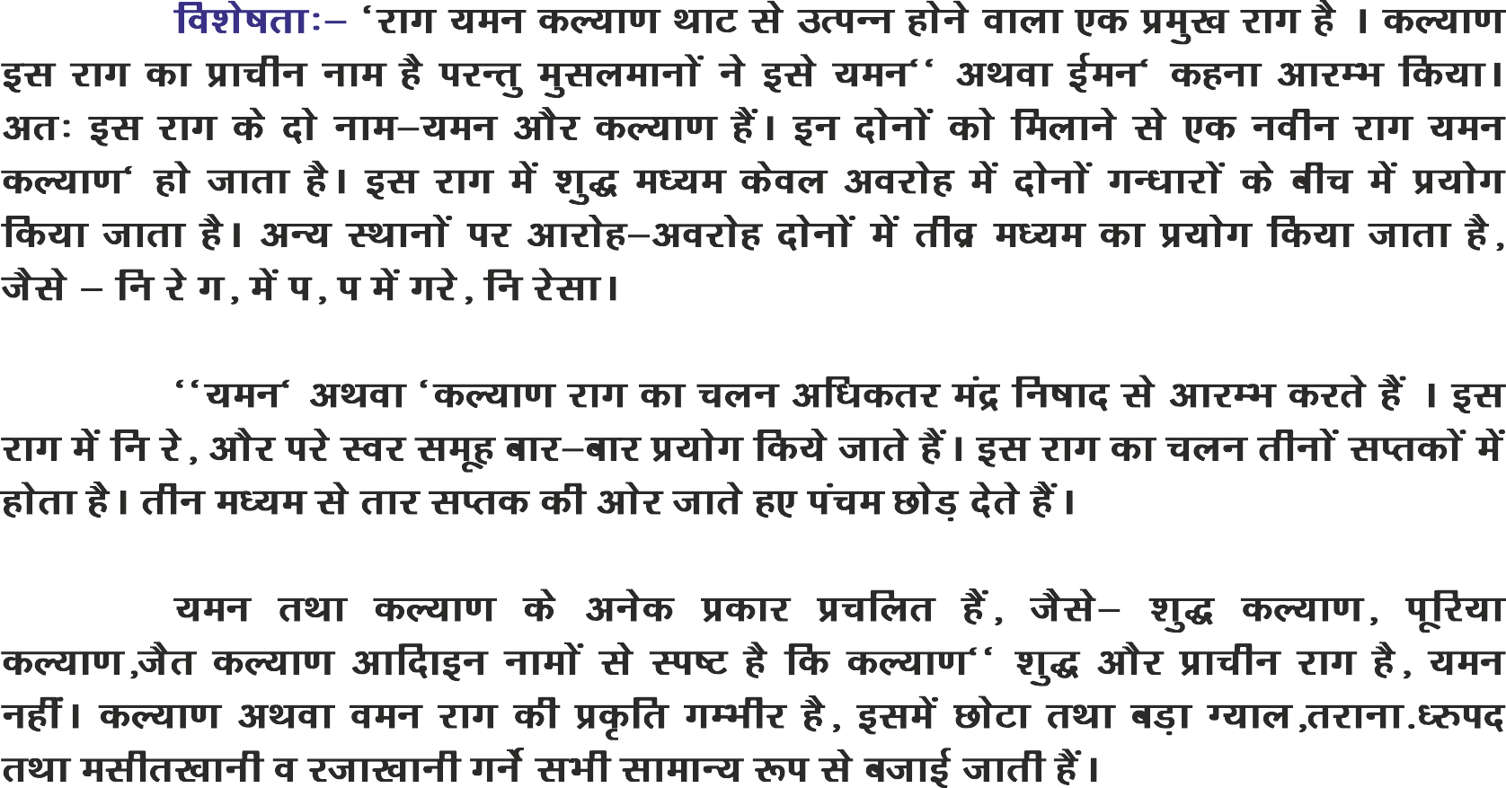

Slide 17
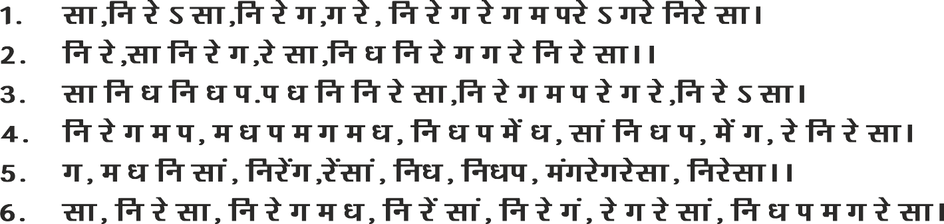

Slide 18
THANK YOU

